Slide 1

AI-BASED RESUME SCREENING SYSTEM
[Institution / department logo]
Final Project Review | Department of Computer Science & Engineering | [Institution Name]
TEAM MEMBERS
2420030545 – mani charan chava
2420030008 – sai teja bandari
Guide: DR. N. SUNANDA|Academic Year: 2026–27
Notes:
Title slide. Replace all bracketed text. Use the full project title, list every team member with registration number, and name your guide. Insert the institution logo in the dashed box.

Slide 2
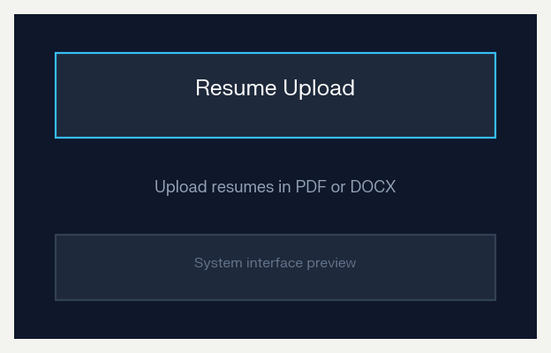



Introduction & Problem Statement
Background
Organisations receive hundreds of resumes for every job opening. Manual screening is slow, inconsistent and may overlook suitable candidates.
Problem Statement
To develop an AI-based system that automatically extracts information from resumes, matches candidates with job requirements and ranks them for recruiters.
Motivation / Need
HR teams and recruiters benefit through faster and fairer shortlisting. Without automation, screening takes excessive time and suitable candidates may be missed.
Notes:
State the domain, the exact problem and why it matters. Keep it to about 2 minutes. Add one real-world statistic if you can, with a citation.

Slide 3


Objectives & Scope
Objectives
1
Design a system to upload and parse resumes in PDF and DOCX formats.
2
Develop an ML model that classifies resumes as shortlisted or rejected with at least 90% accuracy.
3
Extract key candidate details such as skills, experience, education and contact information.
4
Provide a recruiter dashboard that ranks candidates based on job-role compatibility.
Notes:
Objectives should be measurable and start with action verbs. The scope slide tells the panel what you did and did not attempt.

Slide 4

Literature Survey
Author / Year | Method | Limitation | Key Findings | Limitation / Gap
Smith et al., 2021 | Keyword-based resume filtering | Misses semantically similar skills | [Main result] | [Gap or limitation]
Lee et al., 2022 | TF-IDF + Naive Bayes | Limited accuracy on varied resume formats | [Main result] | [Gap or limitation]
Verma et al., 2023 | BERT-based semantic matching | High computational requirement | [Main result] | [Gap or limitation]
Proposed system | TF-IDF + SVM with skill extraction | Balanced accuracy, speed and simplicity | [Main result] | [Gap or limitation]
Research Gap
Many existing tools rely only on keyword matching and do not provide complete resume parsing, classification and recruiter-friendly ranking. This project integrates all these functions in one system.
Notes:
Summarise four to six relevant papers or existing systems. End with the research gap, because that gap justifies your project.

Slide 5





Proposed System & Methodology
STEP 1
STEP 2
STEP 3
STEP 4
STEP 5
Define Problem
Collect Data
Design
Implement
Test & Evaluate
Identify the need, scope and success criteria.
Resume dataset in PDF/DOCX format with job descriptions, skills, experience and shortlisting labels.
TF-IDF text features with SVM classification; skill extraction using keyword matching and NLP preprocessing.
Upload, parsing, preprocessing, classification, ranking and dashboard modules integrated using Python and Flask.
Accuracy, precision, recall, F1-score and processing time evaluated on a held-out test set.
Key Novelty / Contribution
The system combines automated resume parsing, skill extraction, ML-based screening and candidate ranking in a single recruiter dashboard.
Notes:
Walk through the five steps left to right. Rename the steps to match your project (for example, Requirement Analysis, Design, Coding, Testing, Deployment). End with your novelty.

Slide 6
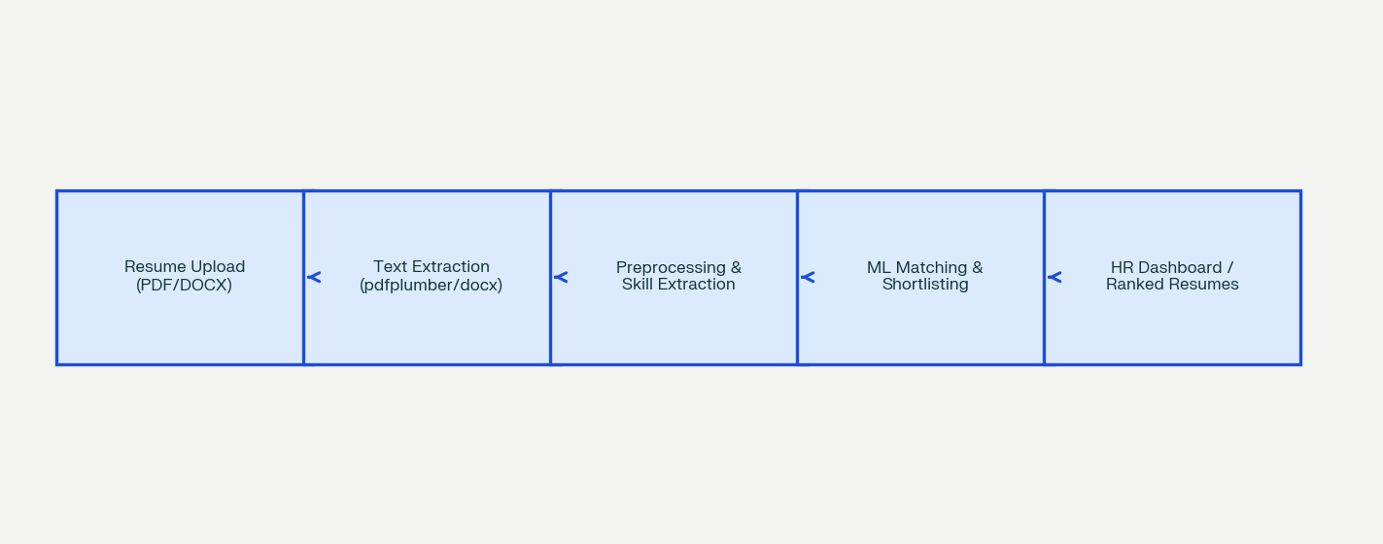
System Architecture
Components
1
Resume Upload Module
Accepts resumes in PDF or DOCX format.
2
Information Extraction Module
Extracts text, skills, education and experience.
3
Screening Module
Classifies and scores resumes against job requirements.
4
Recruiter Dashboard
Displays ranked candidates and screening reports.
Notes:
Insert a clear block diagram: input, processing, storage, output. Number each block and explain them on the right. Redraw the figure yourself rather than copying it.

Slide 7


Hardware & Software Requirements
Hardware
Software & Tools
Libraries / Frameworks
Intel i5 processor or higher
8 GB RAM; 256 GB storage
No special sensors required
Internet connection for deployment
Windows 10 / Ubuntu 22.04
Python 3.10
VS Code / Jupyter Notebook
GitHub
scikit-learn 1.x
NLTK / spaCy
Flask web framework
SQLite / MySQL
Deployment / Platform: [Local machine, Google Colab, Cloud, Web server, Embedded device…]
Notes:
List only what you actually used, with versions. For a pure software project, shorten the hardware list and add cloud or deployment resources.

Slide 8
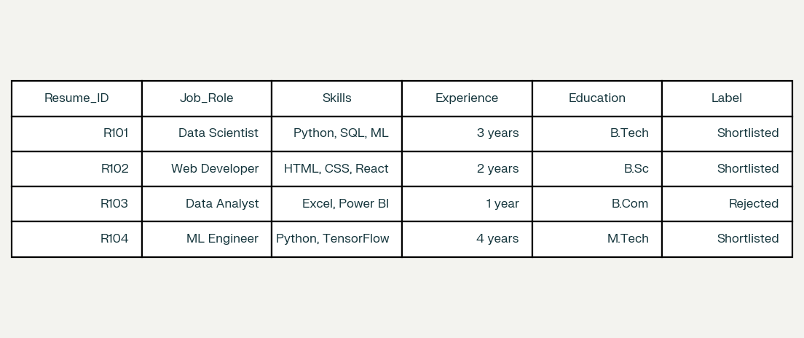
Dataset / Data Understanding
1,000
8
Records (rows)
Features (columns)
0
2
Missing values
Target classes
Source: [Kaggle / UCI / self-collected / sensor]
Features: [key inputs and the target variable]
Quality: [missing values, duplicates, imbalance]
Notes:
Explain where the data came from and what it contains. Show a screenshot of the first rows or the info summary. For non-data projects, replace this slide with “Requirement Analysis” or “Input Specification”.

Slide 9
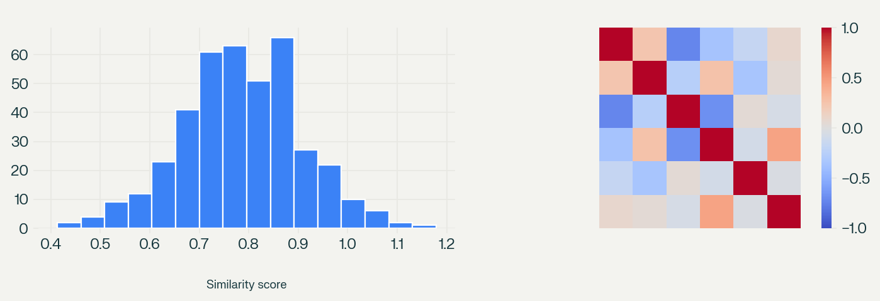



Data Preprocessing & Exploratory Analysis
Cleaning
Transformation
Feature Selection
Duplicate resumes removed; missing fields handled using default values; irrelevant symbols and stop words removed.
Resume text converted using TF-IDF vectors; categorical fields label-encoded; numerical experience values scaled.
TF-IDF selected the most relevant terms; final feature set includes text vectors along with skills, experience and education features.
Notes:
Show two or three plots that tell a story: distributions, correlations, outliers. Explain what each plot told you and what you did about it.

Slide 10
Module-wise Description
1
Resume Upload Module
2
Resume Parsing Module
Purpose: Shows ranked candidates and reports.
Input → Output: Screening results → dashboard view.
Developed by: [Team member name]
Purpose: Shows ranked candidates and reports.
Input → Output: Screening results → dashboard view.
Developed by: [Team member name]
3
Screening Module
4
Dashboard & Report Module
Purpose: Shows ranked candidates and reports.
Input → Output: Screening results → dashboard view.
Developed by: [Team member name]
Purpose: Shows ranked candidates and reports.
Input → Output: Screening results → dashboard view.
Developed by: [Team member name]
Notes:
Divide the project into three to five modules. For each, state its purpose, inputs, outputs and who built it. Duplicate a card if you have more modules.

Slide 11

Algorithms & Technologies Used
TF-IDF Vectorisation
Support Vector Machine
NLP Skill Extraction
Why chosen
Identifies skills, education and experience from unstructured text.
Key parameters
Tokenisation, stop-word removal, lemmatisation
Why chosen
Identifies skills, education and experience from unstructured text.
Key parameters
Tokenisation, stop-word removal, lemmatisation
Why chosen
Identifies skills, education and experience from unstructured text.
Key parameters
Tokenisation, stop-word removal, lemmatisation
Selection criteria: [How the final approach was chosen – metric, cost, speed, simplicity]
Notes:
Name each model, algorithm or technology, say why you chose it, and list the key settings. Then explain how you picked the final one.

Slide 12
Implementation / Model Building
Feature Selection
Code snippet / pseudocode
TF-IDF resume text, extracted skills, experience and education were used because they best represent candidate suitability.
# Paste your key code here
X_train, X_test, y_train, y_test = \
train_test_split(X, y, test_size=0.2,
random_state=42)
pipeline = Pipeline([
("preprocess", preprocessor),
("model", Model())
])
pipeline.fit(X_train, y_train)
Preprocessing Pipeline
Text extraction, cleaning, stop-word removal, lemmatisation, TF-IDF transformation and label encoding.
Data Splitting
70% training, 15% validation and 15% testing.
Configuration
SVM with linear kernel, C = 1.0; TF-IDF limited to 5000 features; stratified split used.
Notes:
Describe the build in the order you did it. Paste only the most important code or pseudocode, not entire files. For hardware projects, show the circuit or wiring summary instead.

Slide 13
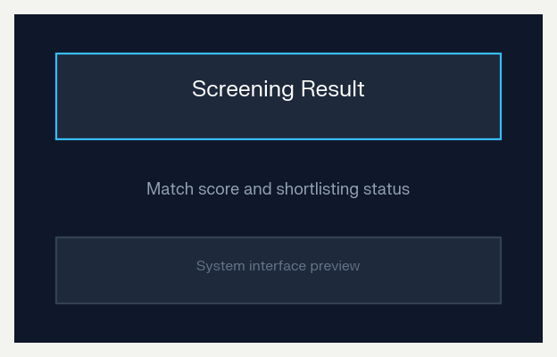
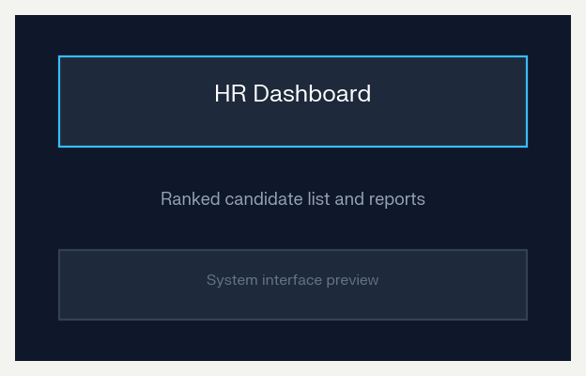
Working Prototype / Output Screens
Resume Upload Screen
Allows recruiters to upload PDF or DOCX resumes.
Screening Result
Displays match score and shortlisting status.
HR Dashboard
Shows ranked candidates and screening reports.
Notes:
Show real screenshots, photos of the hardware or a short demo video link. Caption each one with what the viewer should notice.

Slide 14
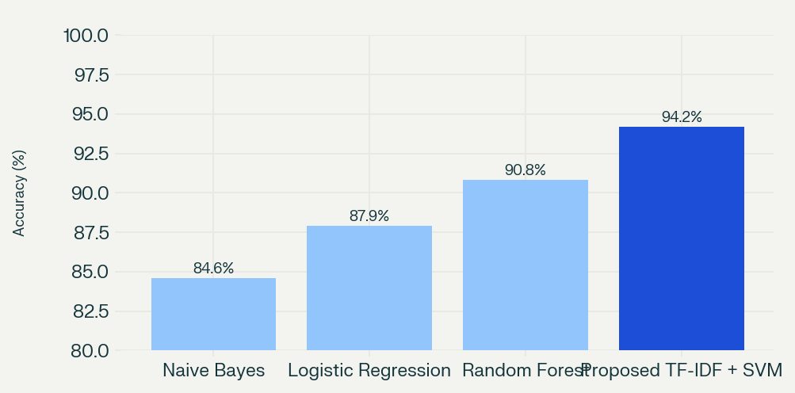
Results & Performance Comparison
Model | Accuracy | Precision | Recall
Naive Bayes | 84.6% | 83.8% | 82.9%
Logistic Regression | 87.9% | 87.1% | 86.4%
Random Forest | 90.8% | 90.2% | 89.5%
Proposed TF-IDF + SVM | 94.2% | 93.7% | 93.1%
ROC-AUC | 0.00 | 0.00 | 0.00
Best: Proposed TF-IDF + SVM – Accuracy = 94.2%
The proposed TF-IDF + SVM model outperformed the baseline models.
Notes:
Right-click the chart and choose Edit Data to enter your real numbers. Replace the metrics with the ones that fit your project (accuracy, latency, power, throughput, user rating). State clearly which option performed best.

Slide 15
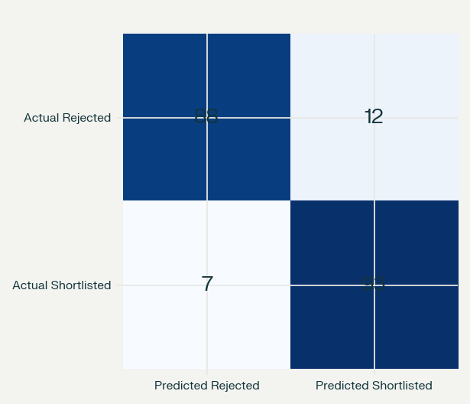
Analysis & Key Findings
94.2%
Best accuracy achieved by the proposed TF-IDF + SVM screening model
Interpretation: The system accurately distinguishes suitable candidates from unsuitable resumes.
Error analysis: Errors occur for unusual resume formats, vague job titles or missing skill information.
Key drivers: Relevant skills, experience, education and job-description similarity.
Notes:
Explain what the numbers mean. Use a confusion matrix, ROC curve, feature-importance chart or output comparison. Be honest about weak results; panels value that.

Slide 16

Testing & Validation
Test Case | Input | Expected Output | Result | Status
TC01 | Valid PDF resume | Text and details extracted | Pass | [Pass / Fail]
TC02 | Invalid/corrupt file | Error message displayed | Pass | [Pass / Fail]
TC03 | Resume matching job role | Shortlisted with score | Pass | [Pass / Fail]
TC04 | Unrelated resume | Rejected with low score | Pass | [Pass / Fail]
Functional Testing
Validation Method
Performance Testing
Unit tests checked parsing, feature extraction and classification; integration tests validated upload-to-dashboard flow.
Hold-out testing on 15% unseen resumes, with recruiter validation of shortlisted candidates.
Average screening time below 2 seconds per resume; stable results across repeated uploads.
Notes:
List representative test cases with expected and actual outcomes. Name the validation methods you used. Delete rows you do not need.

Slide 17


Challenges & Limitations
Challenges Faced
Limitations
Different resume formats → used pdfplumber and python-docx parsers.
Unstructured text → applied NLP cleaning and TF-IDF features.
Class imbalance → used stratified splitting and balanced evaluation metrics.
Limited to English resumes.
Accuracy depends on quality of resume text.
Does not yet assess soft skills or interview performance.
Notes:
Be candid. Pair every challenge with how you solved it, and list limitations that the panel would otherwise spot themselves.

Slide 18

Conclusion
An AI-based resume screening system was developed using Python, NLP, TF-IDF features and an SVM classifier on a Flask web platform.
1
Final Outcome
The proposed model achieved 94.2% accuracy, higher than Naive Bayes (84.6%), Logistic Regression (87.9%) and Random Forest (90.8%).
94.2%
2
Screening accuracy achieved
Objectives achieved: 4 of 4
It meets the objectives by automating resume parsing, screening and candidate ranking, saving recruiter time.
3
Notes:
Revisit each objective and say whether you met it. Quote your headline result with numbers. Do not introduce new material here.

Slide 19



Future Scope & Applications
Improve Performance
[Tuning, better models or optimisation]
Applications
Recruitment agencies for bulk resume screening.
Companies for campus placement shortlisting.
Job portals for candidate-job matching.
HR departments and recruiters would adopt it.
Expand Data / Features
[More data, sensors, languages or users]
Deploy & Build an Interface
[Web or mobile app, dashboard, API]
Scale & Secure
[Cloud deployment, privacy, reliability]
Notes:
Give concrete next steps, ideally tied to the limitations. Then name two or three real-world uses.

Slide 20
Team Contribution
Team Member | Reg. No. | Contribution
[NAME 1] | [Reg. No.] | Dataset collection, preprocessing and model training
[NAME 2] | [Reg. No.] | Resume parsing, feature extraction and screening module
[NAME 3] | [Reg. No.] | Flask dashboard, database, testing and documentation
[Reg. No.] | [Member 4] | [Modules, tasks and report sections]
Notes:
Show that work was planned and shared. Every member should be able to explain their own module.

Slide 21

References
[1] S. Robertson, “Understanding Inverse Document Frequency: On Theoretical Arguments for IDF,” Journal of Documentation, 2004.
[2] C. Cortes and V. Vapnik, “Support-Vector Networks,” Machine Learning, 1995.
[3] Kaggle, “Resume Dataset,” 2026. [Online]. Available: https://www.kaggle.com
[4] Scikit-learn, “TF-IDF Vectorizer Documentation,” 2026. [Online]. Available: https://scikit-learn.org
[5] spaCy, “Industrial-Strength Natural Language Processing,” 2026. [Online]. Available: https://spacy.io
Project Links
GitHub: [Add repository URL]
Dataset: Kaggle resume dataset / collected resumes
Demo video: [Add video URL]
Notes:
Use IEEE style, numbered in order of first citation in the deck. Include datasets, documentation and code repositories.

Slide 22
THANK YOU
Questions & Discussion
[Team email / contact details]
[Guide name and department]
Notes:
Leave this slide up during questions. Make sure every team member can answer questions about their own module.

